Slide 1
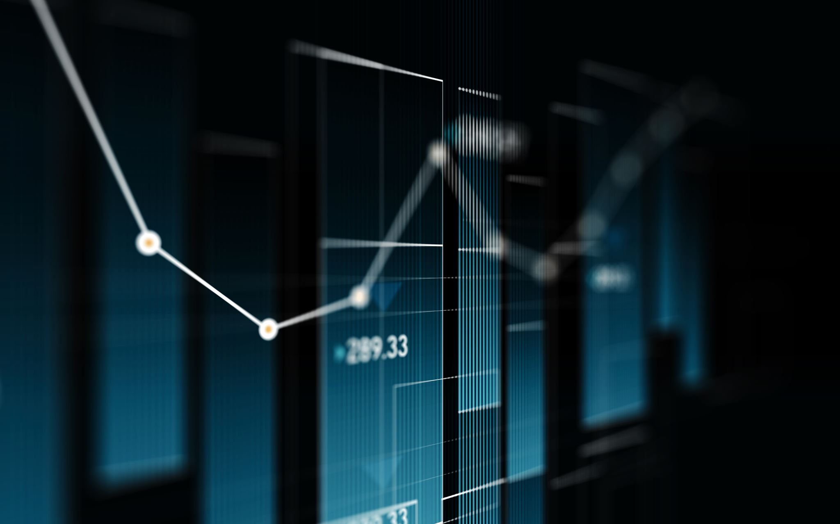
Detection of Fake News
Alex Laughlin, Xandre Clementsmith, Terence Carey

Slide 2
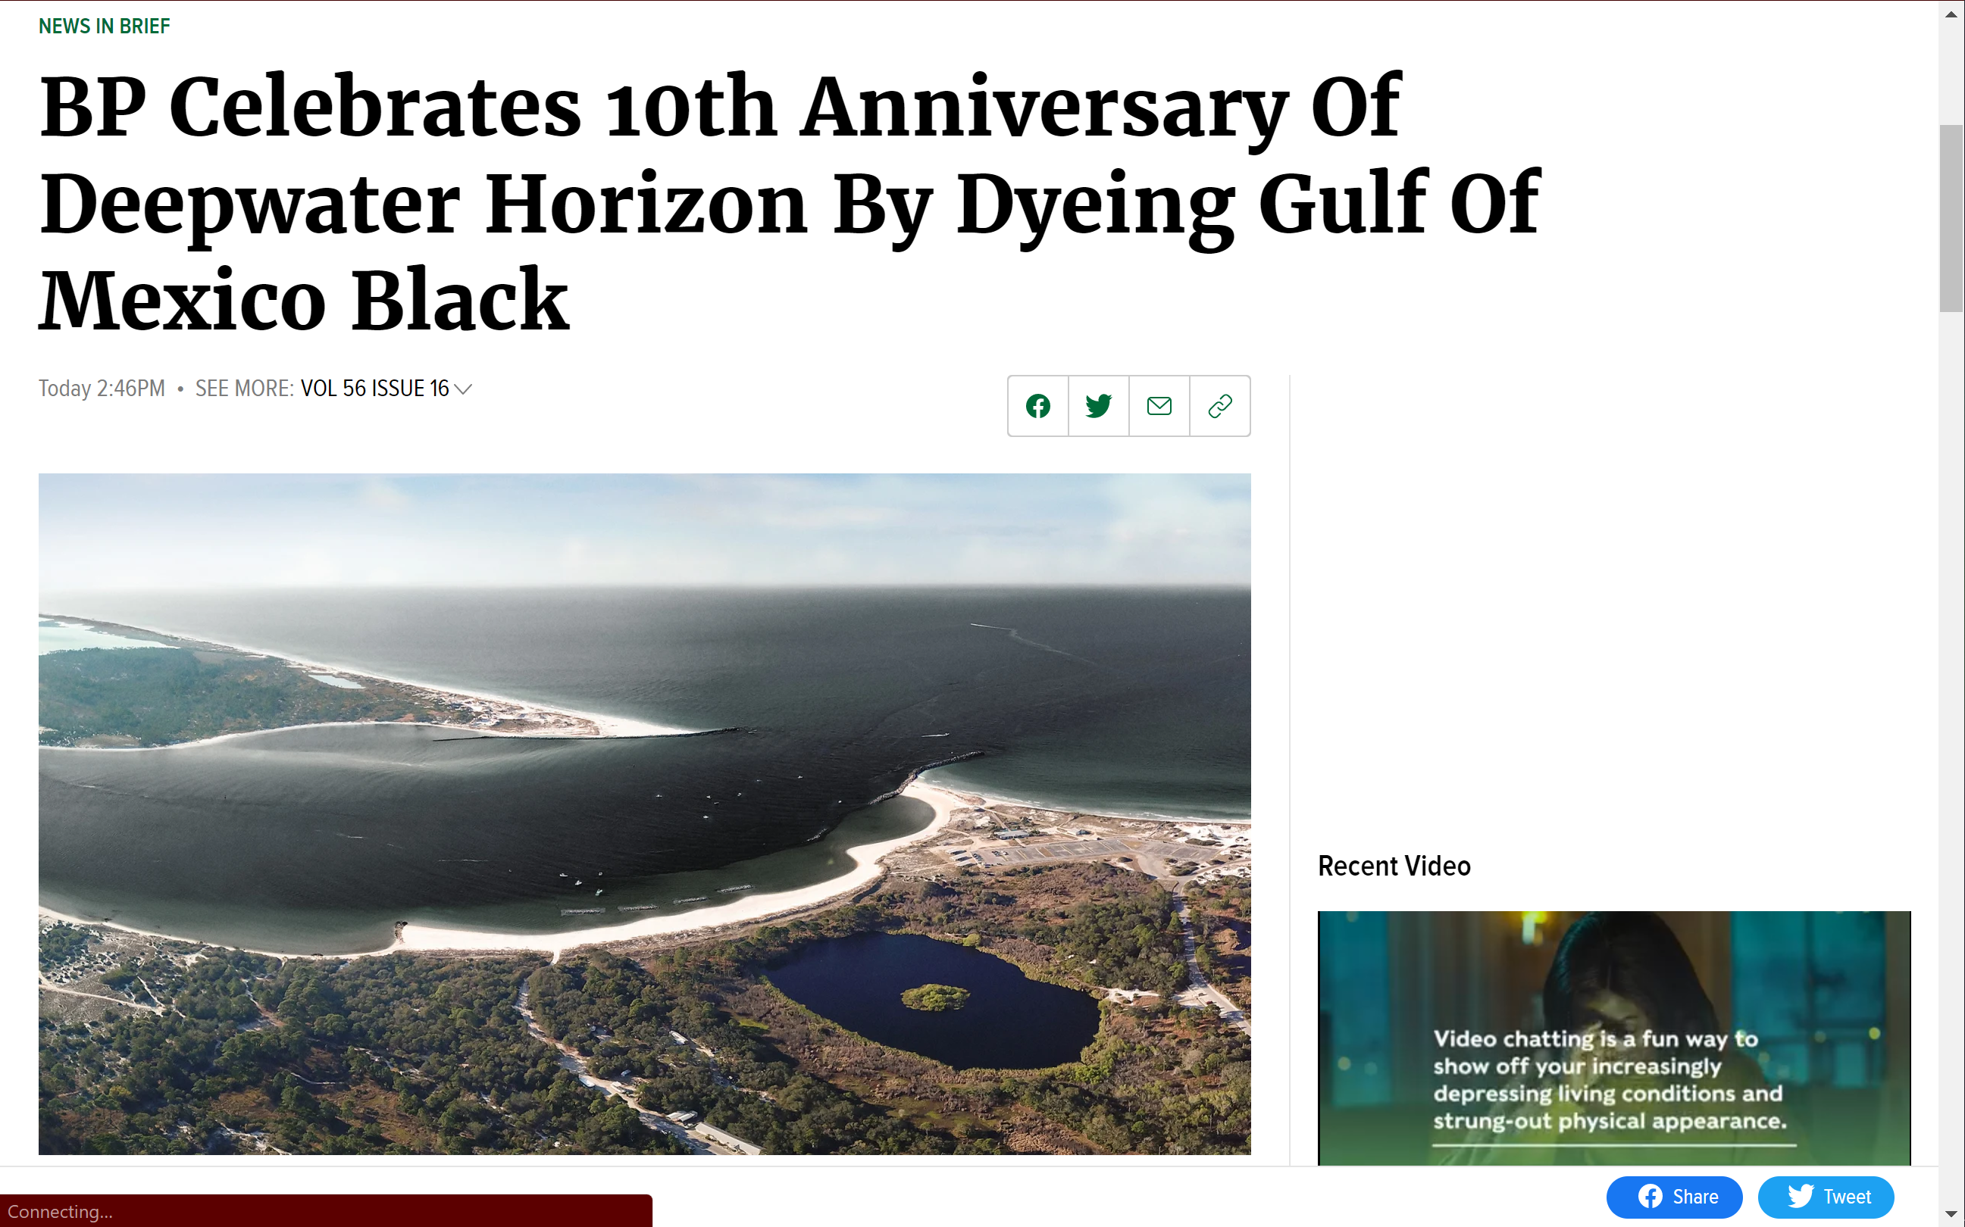

Slide 3
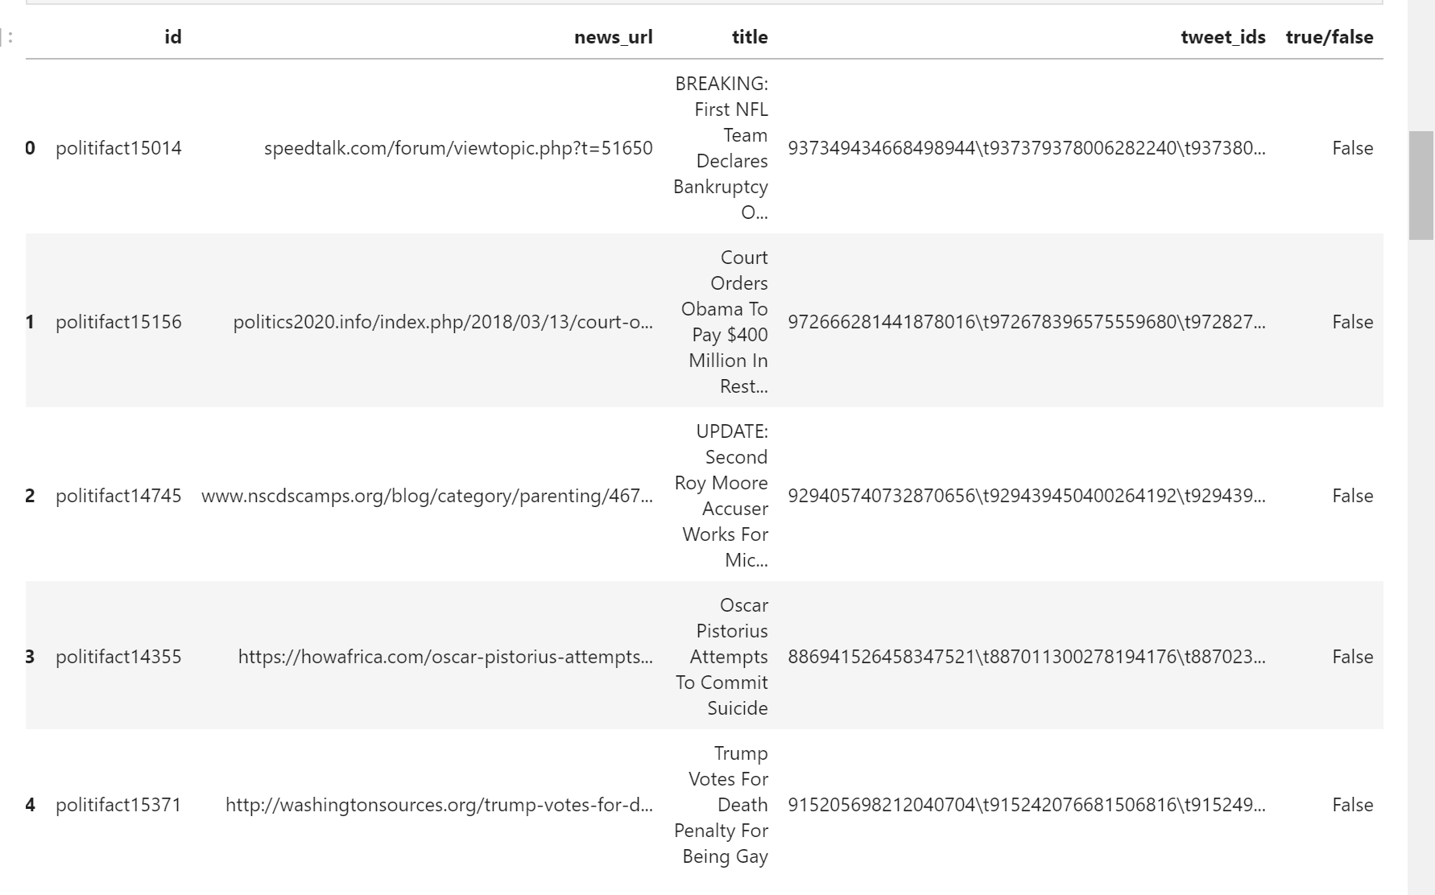
Data from politifact and gossipcop
Analysis is based on titles

Slide 4
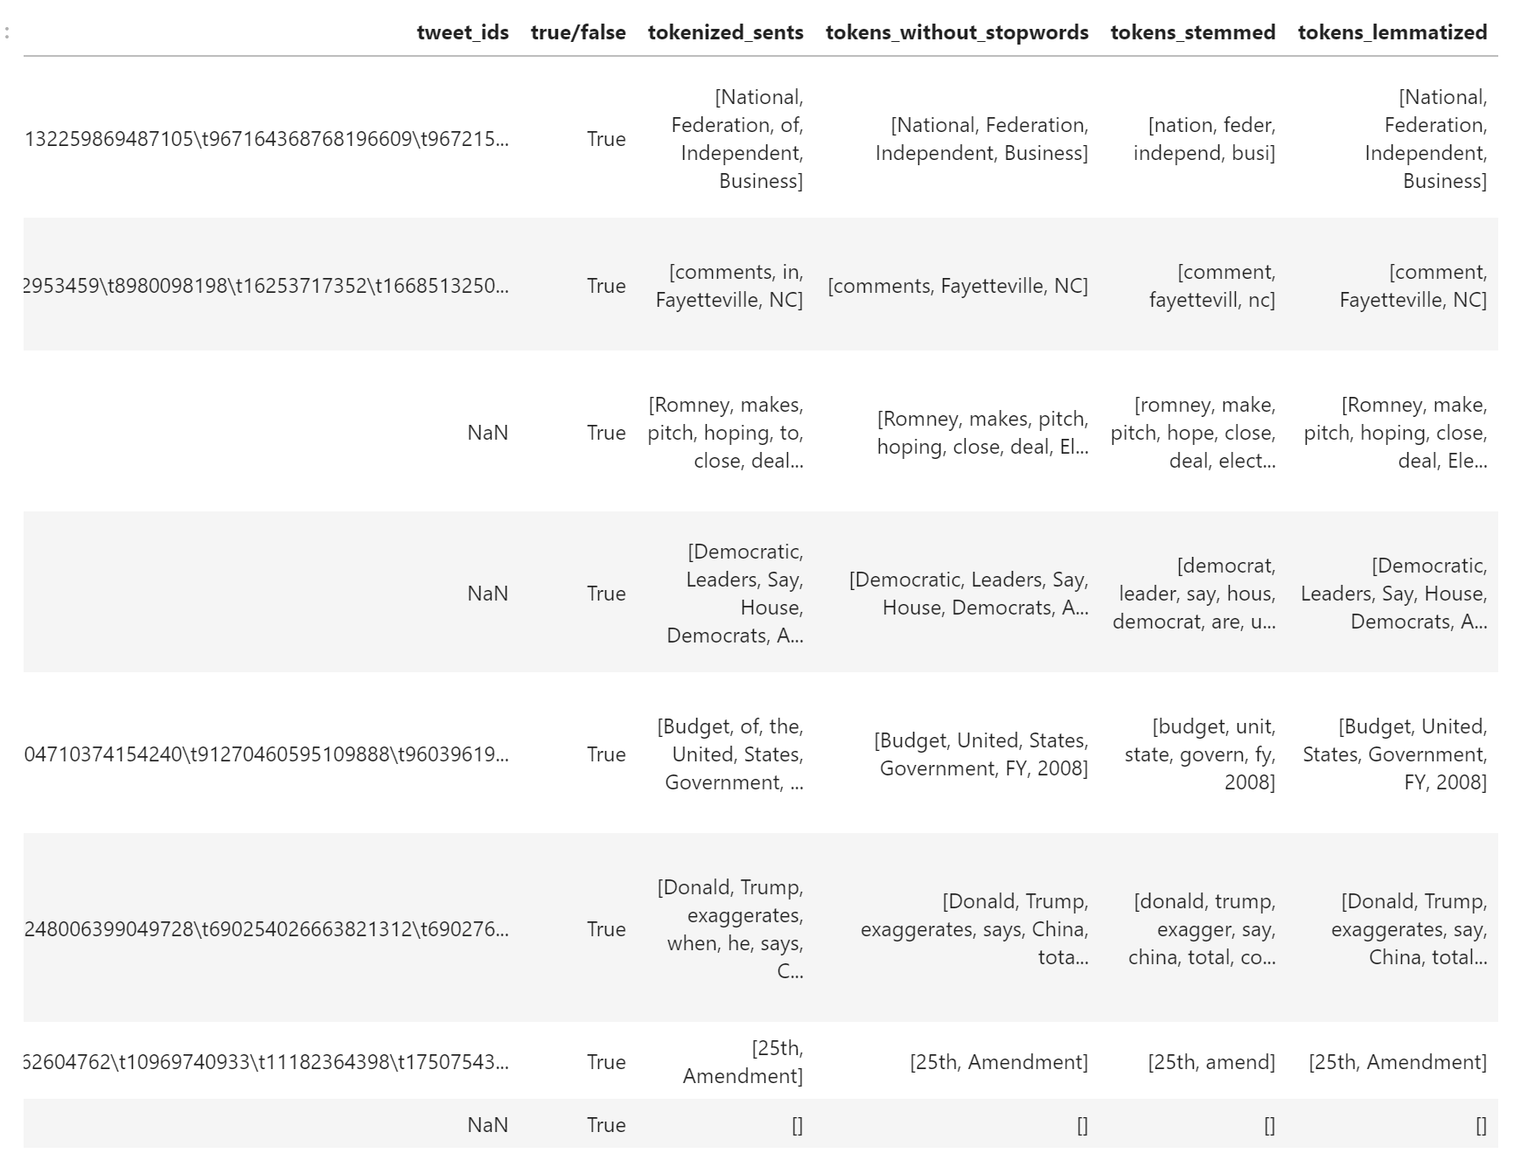
Tokenization based on stopwords, stemming, and lemmatization

Slide 5
Machine Learning Algorithm Comparison

Slide 6
85%

Slide 7
Thank you

